Slide 1
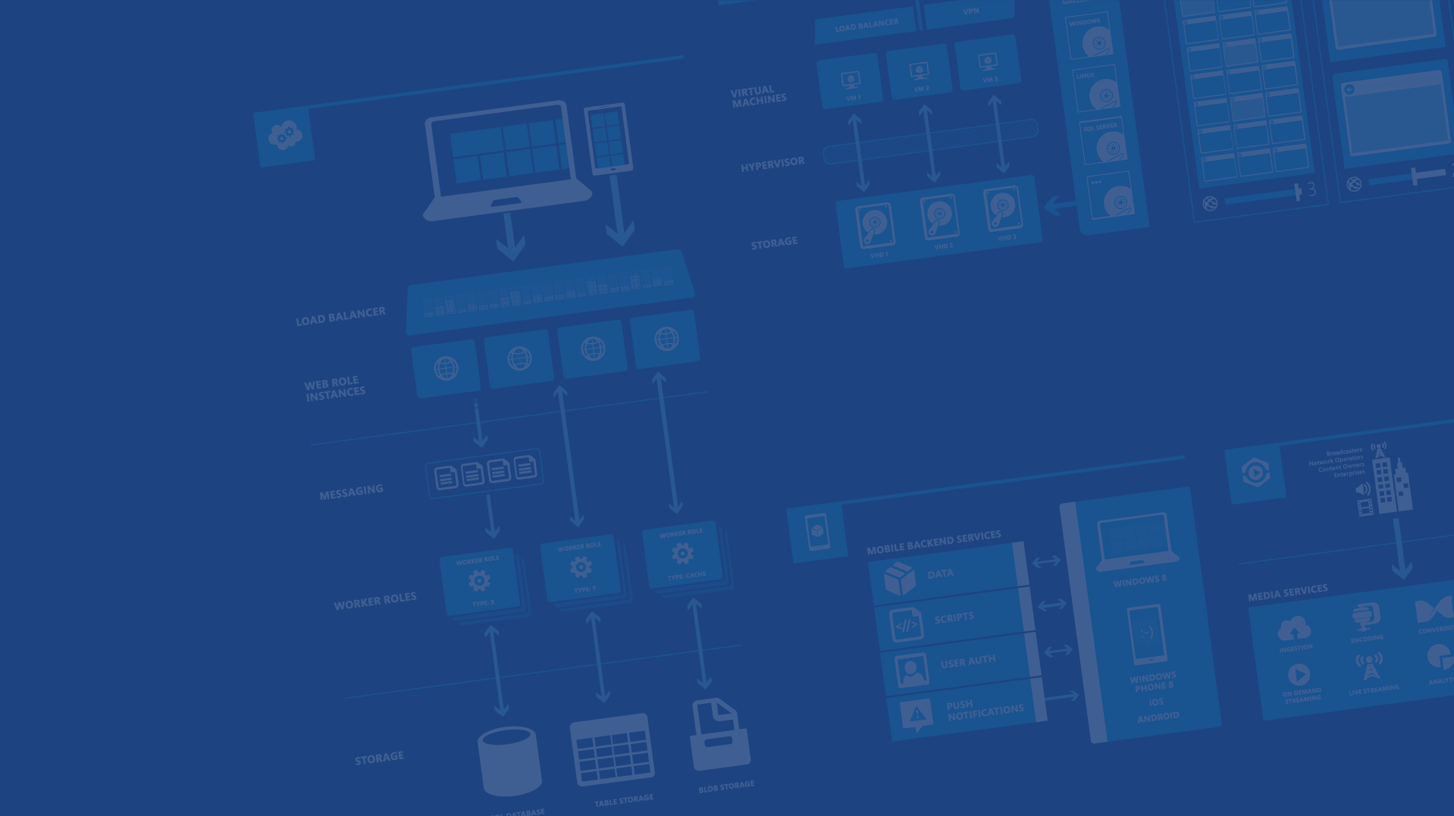
Polyglot Persistence in Microsoft Azure
Charalampos Karypidis
Freelance Software Engineer .NET - JavaScript
@xabikos
Microsoft Azure

Slide 2
Agenda
Blobs
Redis Cache
Tables
SQL Databases
Queues
DocumentDB

Slide 3


Microsoft Azure Data Services
SQL Server in a VM
SQL Database
DocumentDB
Tables
Blobs
fully managed, scalable, queryable, schemafree JSON document database service for modern applications
fully featured RDBMS
transactional processing
rich query
managed as a service
elastic scale
schema-free data model
internet accessible http/rest
arbitrary data formats

Slide 4
Microsoft Azure Storage Blob

Slide 5
Two Types of Blobs Under the Hood
Block Blob Page Blob
Notes:
Slide Objective
Understand that there are two blob types

Slide 6
Block Blob
Targeted at streaming workloads
Each blob consists of a sequence of blocks
Each block is identified by a Block ID
Size limit 200GB per blob
Optimistic Concurrency via Etags
Notes:
Slide Objective
Understand block blob
Speaker Notes
Block blobs are comprised of blocks, each of which is identified by a block ID.
You create or modify a block blob by uploading a set of blocks and committing them by their block IDs.
If you are uploading a block blob that is no more than 64 MB in size, you can also upload it in its entirety with a single Put Blob operation.
When you upload a block to Microsoft Azure using the Put Block operation, it is associated with the specified block blob, but it does not become part of the blob until you call the Put Block List operation and include the block's ID.
The block remains in an uncommitted state until it is specifically committed. Writing to a block blob is thus always a two-step process.
Each block can be a maximum of 4 MB in size. The maximum size for a block blob in version 2009-09-19 is 200 GB, or up to 50,000 blocks.
Notes
http://msdn.microsoft.com/en-us/library/dd135734.aspx

Slide 7
Page Blob
Targeted at random read/write workloads
Each blob consists of an array of pages
Each page is identified by its offset from the start of the blob
Size limit 1TB per blob
Optimistic or Pessimistic (locking) concurrency via leases
Notes:
Slide Objective
Understand page blob
Speaker Notes
Page blobs are a collection of pages.
A page is a range of data that is identified by its offset from the start of the blob.
To create a page blob, you initialize the page blob by calling Put Blob and specifying its maximum size.
To add content to or update a page blob, you call the Put Page operation to modify a page or range of pages by specifying an offset and range. All pages must align 512-byte page boundaries.
Unlike writes to block blobs, writes to page blobs happen in-place and are immediately committed to the blob.
The maximum size for a page blob is 1 TB.
A page written to a page blob may be up to 1 TB in size but will typically be much smaller
Notes
http://msdn.microsoft.com/en-us/library/dd135734.aspx

Slide 8
Blob Storage Concepts
http://{account}.blob.core.windows.net/{container}/{blobname}
Account
Container
Blob
Pages/Blocks
PIC01.JPG
images
Block/Page
PIC02.JPG
contoso
Block/Page
videos
VID1.AVI
Notes:
Slide Objectives
Understand the hierarchy of Blob storage
Speaker Notes
The Blob service provides storage for entities, such as binary files and text files.
The REST API for the Blob service exposes two resources:
Containers
Blobs.
A container is a set of blobs; every blob must belong to a container.
The Blob service defines two types of blobs:
Block blobs, which are optimized for streaming.
Page blobs, which are optimized for random read/write operations and which provide the ability to write to a range of bytes in a blob.
Blobs can be read by calling the Get Blob operation. A client may read the entire blob, or an arbitrary range of bytes.
Block blobs less than or equal to 64 MB in size can be uploaded by calling the Put Blob operation.
Block blobs larger than 64 MB must be uploaded as a set of blocks, each of which must be less than or equal to 4 MB in size.
Page blobs are created and initialized with a maximum size with a call to Put Blob.
To write content to a page blob, you call the Put Page operation. The maximum size currently supported for a page blob is 1 TB.
Notes
http://msdn.microsoft.com/en-us/library/dd573356.aspx
Using the REST API for the Blob service, developers can create a hierarchical namespace similar to a file system. Blob names may encode a hierarchy by using a configurable path separator. For example, the blob names MyGroup/MyBlob1 and MyGroup/MyBlob2 imply a virtual level of organization for blobs. The enumeration operation for blobs supports traversing the virtual hierarchy in a manner similar to that of a file system, so that you can return a set of blobs that are organized beneath a group. For example, you can enumerate all blobs organized under MyGroup/.

Slide 9
Blob Details – Containers
Multiple Containers per Account (unlimited number)
A container holds a set of blobs
Set access policies at the container level
Associate Metadata with Container
List the blobs in a container
Including Blob Metadata and MD5 no search on metadata WHERE MetadataValue = ?
Notes:
Slide Objective
Understand containers
Speaker Notes
Metadata is up to 8KB of name value pairs per container
Notes
http://msdn.microsoft.com/en-us/library/dd179361.aspx
http://msdn.microsoft.com/en-us/library/ee395424.aspx

Slide 10
Blob Details – Metadata
Standard HTTP metadata/headers (Cache-Control, Content-Encoding, Content-Type, etc)
Metadata is <name, value> pairs, up to 8KB per blob
Either as part of PutBlob or independently

Slide 11
Blob Details – Access method
Can include ‘/‘ or other delimiter in name
e.g. /<container>/myblobs/smurf.png
blob name
Notes:
Slide Objectives
Understand the hierarchy of Blob storage
Speaker Notes
Put Blob - Creates a new blob or replaces an existing blob within a container.
Get Blob - Reads or downloads a blob from the system, including its metadata and properties.
Delete Blob - Deletes a blob
Copy Blob - Copies a source blob to a destination blob within the same storage account.
SnapShot Blob - The Snapshot Blob operation creates a read-only snapshot of a blob.
Lease Blob - Establishes an exclusive one-minute write lock on a blob. To write to a locked blob, a client must provide a lease ID.
Using the REST API for the Blob service, developers can create a hierarchical namespace similar to a file system.
Blob names may encode a hierarchy by using a configurable path separator. For example, the blob names MyGroup/MyBlob1 and MyGroup/MyBlob2 imply a virtual level of organization for blobs.
The enumeration operation for blobs supports traversing the virtual hierarchy in a manner similar to that of a file system, so that you can return a set of blobs that are organized beneath a group.
For example, you can enumerate all blobs organized under MyGroup/.
Notes
The Blob service provides storage for entities, such as binary files and text files. The REST API for the Blob service exposes two resources: containers and blobs. A container is a set of blobs; every blob must belong to a container. The Blob service defines two types of blobs:
Block blobs, which are optimized for streaming. This type of blob is the only blob type available with versions prior to 2009-09-19.
Page blobs, which are optimized for random read/write operations and which provide the ability to write to a range of bytes in a blob. Page blobs are available only with version 2009-09-19.
Containers and blobs support user-defined metadata in the form of name-value pairs specified as headers on a request operation.
Using the REST API for the Blob service, developers can create a hierarchical namespace similar to a file system. Blob names may encode a hierarchy by using a configurable path separator. For example, the blob names MyGroup/MyBlob1 and MyGroup/MyBlob2 imply a virtual level of organization for blobs. The enumeration operation for blobs supports traversing the virtual hierarchy in a manner similar to that of a file system, so that you can return a set of blobs that are organized beneath a group. For example, you can enumerate all blobs organized under MyGroup/.
A block blob may be created in one of two ways. Block blobs less than or equal to 64 MB in size can be uploaded by calling the Put Blob operation. Block blobs larger than 64 MB must be uploaded as a set of blocks, each of which must be less than or equal to 4 MB in size. A set of successfully uploaded blocks can be assembled in a specified order into a single contiguous blob by calling Put Block List. The maximum size currently supported for a block blob is 200 GB.
Page blobs are created and initialized with a maximum size with a call to Put Blob. To write content to a page blob, you call the Put Page operation. The maximum size currently supported for a page blob is 1 TB.
Blobs support conditional update operations that may be useful for concurrency control and efficient uploading.
Blobs can be read by calling the Get Blob operation. A client may read the entire blob, or an arbitrary range of bytes.
For the Blob service API reference, see Blob Service API.

Slide 12
Microsoft Azure Storage Table

Slide 13
Table Storage Concepts
Account
Table
Entity
Name =…
Email = …
customers
Name =…
EMailAdd=
contoso
Photo ID =…
Date =…
photos
Photo ID =…
Date =…
Notes:
Slide Objectives
Understand Tables
Speaker Notes
The Table service provides structured storage in the form of tables.
The Table service supports a REST API that is compliant with the ADO.NET Data Services REST API.
Developers may also use the .NET Client Library for ADO.NET Data Services to access the Table service.
Notes
http://msdn.microsoft.com/en-us/library/dd573356.aspx

Slide 14
Table Storage Details
Entity can have up to 255 properties
Up to 1MB per entity
Notes:
Slide Objectives
Understand Tables and Entities
Speaker Notes
Tables store data as entities.
An entity is a collection of named properties and their values, similar to a row- not an RDBMS though
Tables are partitioned to support load balancing across storage nodes.
Each table has as its first property a partition key that specifies the partition an entity belongs to.
The second property is a row key that identifies an entity within a given partition.
The combination of the partition key and the row key forms a primary key that identifies each entity uniquely within the table.
The Table service does not enforce any schema.
A developer may choose to implement and enforce a schema on the client side
Notes
http://msdn.microsoft.com/en-us/library/dd573356.aspx
http://msdn.microsoft.com/en-us/library/dd179338.aspx

Slide 15
Table Storage Details Entity Properties
Not an RDBMS Table!
The mental picture is ‘Entities’
Notes:
Slide Objectives
Understand Tables
Speaker Notes
Within a storage account, a developer may create named tables.
Tables store data as entities.
An entity is a collection of named properties and their values, similar to a row.
Tables are partitioned to support load balancing across storage nodes.
Each table has as its first property a partition key that specifies the partition an entity belongs to.
The second property is a row key that identifies an entity within a given partition.
The combination of the partition key and the row key forms a primary key that identifies each entity uniquely within the table.
The Table service does not enforce any schema.
A developer may choose to implement and enforce a schema on the client side
Notes
http://msdn.microsoft.com/en-us/library/dd573356.aspx

Slide 16
Table Storage Details Entity Properties
PartitionKey & RowKey are mandatory properties
Composite key which uniquely identifies an entity
They are the only indexed properties
Defines the sort order
Notes:
Slide Objectives
Understand Tables and Entities
Speaker Notes
Tables store data as entities.
An entity is a collection of named properties and their values, similar to a row- not an RDBMS though
Tables are partitioned to support load balancing across storage nodes.
Each table has as its first property a partition key that specifies the partition an entity belongs to.
The second property is a row key that identifies an entity within a given partition.
The combination of the partition key and the row key forms a primary key that identifies each entity uniquely within the table.
The Table service does not enforce any schema.
A developer may choose to implement and enforce a schema on the client side
Notes
http://msdn.microsoft.com/en-us/library/dd573356.aspx
http://msdn.microsoft.com/en-us/library/dd179338.aspx

Slide 17
Table Storage Details Entity Properties
No fixed schema for other properties
Each property is stored as: <name, typed value>
Properties can be the standard .NET types:
string, binary, bool, DateTime, GUID, int, int64, double
Notes:
Slide Objectives
Understand Tables and Entities
Speaker Notes
Tables store data as entities.
An entity is a collection of named properties and their values, similar to a row- not an RDBMS though
Tables are partitioned to support load balancing across storage nodes.
Each table has as its first property a partition key that specifies the partition an entity belongs to.
The second property is a row key that identifies an entity within a given partition.
The combination of the partition key and the row key forms a primary key that identifies each entity uniquely within the table.
The Table service does not enforce any schema.
A developer may choose to implement and enforce a schema on the client side
Notes
http://msdn.microsoft.com/en-us/library/dd573356.aspx
http://msdn.microsoft.com/en-us/library/dd179338.aspx

Slide 18
Table Storage Details Entity Properties
Timestamp property
Optimistic Concurrency
Exposed as an HTTP Etag
Notes:
Slide Objectives
Understand Tables and Entities
Speaker Notes
Tables store data as entities.
An entity is a collection of named properties and their values, similar to a row- not an RDBMS though
Tables are partitioned to support load balancing across storage nodes.
Each table has as its first property a partition key that specifies the partition an entity belongs to.
The second property is a row key that identifies an entity within a given partition.
The combination of the partition key and the row key forms a primary key that identifies each entity uniquely within the table.
The Table service does not enforce any schema.
A developer may choose to implement and enforce a schema on the client side
Notes
http://msdn.microsoft.com/en-us/library/dd573356.aspx
http://msdn.microsoft.com/en-us/library/dd179338.aspx

Slide 19
Table Storage Details Purpose of the PatitionKey
Entity Locality
Entity Group Transactions
Table Scalability
Notes:
Slide Objectives
Understand Tables and Entities
Speaker Notes
Tables store data as entities.
An entity is a collection of named properties and their values, similar to a row- not an RDBMS though
Tables are partitioned to support load balancing across storage nodes.
Each table has as its first property a partition key that specifies the partition an entity belongs to.
The second property is a row key that identifies an entity within a given partition.
The combination of the partition key and the row key forms a primary key that identifies each entity uniquely within the table.
The Table service does not enforce any schema.
A developer may choose to implement and enforce a schema on the client side
Notes
http://msdn.microsoft.com/en-us/library/dd573356.aspx
http://msdn.microsoft.com/en-us/library/dd179338.aspx

Slide 20
Table Storage Details Purpose of the PatitionKey
Entity Locality
Entities in the same partition will be stored together
Efficient querying and cache locality
Endeavour to include partition key in all queries
Notes:
Slide Objectives
Understand The Partition Key
Speaker Notes
Tables are partitioned to support load balancing across storage nodes.
A table's entities are organized by partition.
A partition is a consecutive range of entities possessing the same partition key value.
The partition key is a unique identifier for the partition within a given table, specified by the PartitionKey property.
The partition key forms the first part of an entity's unique identifier within the table.
The partition key may be a string value up to 1 KB in size.
You must include the PartitionKey property in every insert, update, and delete operation.
Notes
http://msdn.microsoft.com/en-us/library/dd573356.aspx
http://blogs.msdn.com/b/windowsazurestorage/archive/2010/05/07/understanding-the-scalability-availability-durability-and-billing-of-windows-azure-storage.aspx
http://blogs.msdn.com/b/windowsazurestorage/archive/2010/05/10/windows-azure-storage-abstractions-and-their-scalability-targets.aspx

Slide 21
Table Storage Details Purpose of the PatitionKey
Entity Group Transactions
Atomic multiple CRUD in same partition in a single transaction
Notes:
Slide Objectives
Understand The Partition Key
Speaker Notes
Tables are partitioned to support load balancing across storage nodes.
A table's entities are organized by partition.
A partition is a consecutive range of entities possessing the same partition key value.
The partition key is a unique identifier for the partition within a given table, specified by the PartitionKey property.
The partition key forms the first part of an entity's unique identifier within the table.
The partition key may be a string value up to 1 KB in size.
You must include the PartitionKey property in every insert, update, and delete operation.
Notes
http://msdn.microsoft.com/en-us/library/dd573356.aspx
http://blogs.msdn.com/b/windowsazurestorage/archive/2010/05/07/understanding-the-scalability-availability-durability-and-billing-of-windows-azure-storage.aspx
http://blogs.msdn.com/b/windowsazurestorage/archive/2010/05/10/windows-azure-storage-abstractions-and-their-scalability-targets.aspx

Slide 22
Table Storage Details Purpose of the PatitionKey
Table Scalability
Target throughput – 500 tps/partition, several thousand tps/account
Microsoft Azure monitors the usage patterns of partitions
Automatically load balance partitions
Each partition can be served by a different storage node
Scale to meet the traffic needs of your table
Notes:
Slide Objectives
Understand The Partition Key
Speaker Notes
Tables are partitioned to support load balancing across storage nodes.
A table's entities are organized by partition.
A partition is a consecutive range of entities possessing the same partition key value.
The partition key is a unique identifier for the partition within a given table, specified by the PartitionKey property.
The partition key forms the first part of an entity's unique identifier within the table.
The partition key may be a string value up to 1 KB in size.
You must include the PartitionKey property in every insert, update, and delete operation.
Notes
http://msdn.microsoft.com/en-us/library/dd573356.aspx
http://blogs.msdn.com/b/windowsazurestorage/archive/2010/05/07/understanding-the-scalability-availability-durability-and-billing-of-windows-azure-storage.aspx
http://blogs.msdn.com/b/windowsazurestorage/archive/2010/05/10/windows-azure-storage-abstractions-and-their-scalability-targets.aspx

Slide 23
Table Storage Details
Table Scalability
Target throughput – 500 tps/partition, several thousand tps/account
Microsoft Azure monitors the usage patterns of partitions
Automatically load balance partitions
Each partition can be served by a different storage node
Scale to meet the traffic needs of your table
Notes:
Slide Objectives
Understand Tables
Speaker Notes
Within a storage account, a developer may create named tables.
Tables store data as entities.
An entity is a collection of named properties and their values, similar to a row.
Tables are partitioned to support load balancing across storage nodes.
Each table has as its first property a partition key that specifies the partition an entity belongs to.
The second property is a row key that identifies an entity within a given partition.
The combination of the partition key and the row key forms a primary key that identifies each entity uniquely within the table.
The Table service does not enforce any schema.
A developer may choose to implement and enforce a schema on the client side
Notes
http://msdn.microsoft.com/en-us/library/dd573356.aspx

Slide 24
Microsoft Azure Storage Queue

Slide 25
Why use a Queue
Queue length reflects how well the backend processing nodes are doing
Decouples the application
Flexibility of efficient resource usage within an application
Absorb traffic bursts and reduce the impact of individual component failures
Notes:
First of all, the queue length directly reflects how well the backend processing nodes are catching up with the overall workload.
Second, the use of queues decouples different parts of the application, making it easier to scale different parts of the application independently.
Third, the use of queues allows the flexibility of efficient resource usage within an application, allowing the application to scale more efficiently. That is, separate queues can be used for work items of different priorities and/or different weights, and separate pools of backend servers can process these different queues.
Queues provide buffering to absorb traffic bursts and reduce the impact of individual component failures.

Slide 26
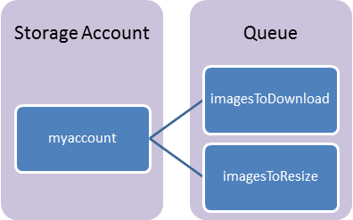
Queue Components
Storage Account: All access to Azure Storage is done through a storage account.
Queue: A queue contains a set of messages.
Message: A message, in any format, of up to 64KB.
http://{storage-account}.queue.core.windows.net/{queue}

Slide 27
Queue-based Load Levelling Pattern
Producers
Consumers
P₁
C₁
Queue
4
3
2
1
P₂
C₂

Slide 28
Queue Considerations
Messages are ordered but not guaranteed FIFO
Message will be processed at least once
Message may be processed more than once
DequeueCount increases every time
Processing must be idempotent
Messages are stored up to 7 days

Slide 29
Microsoft Azure SQL Database

Slide 30
SQL Database The Basics
SQL Server database technology “as a Service”
Fully Managed
Enterprise-ready with automatic support for HA, DR, Backups, replication and more
Notes:
Slide Objectives:
Understand the overall concepts and benefits of SQL Database
Transition:
Let’s clear up any confusion and look at the basics of what SQL Database really is and some of its benefits.
Speaking Points:
The same great SQL Server database technology that you know, love, and use on-premises provided as a service
Enterprise-ready
Automatic support for High-Availability
Designed to scale on-demand to provide the same great elasticity
Notes:
High-availability – 3 copies of the database free for the cost of the one database. Always in sync. The cost to do this on-premises isn’t cheap. This is FREE in SQL Database.

Slide 31
A Server is not a machine
SQL Server
Machine
(Physical/VM)
Azure
SQL Database Server
TDS Endpoint
Notes:
Slide Objectives:
Understand that while there are physical SQL Server boxes behind the scenes, when connecting to SQL Database, you are not connecting to a physical server, but to a TDS endpoint.
Transition:
The key to understanding SQL Database is understanding while SQL Database is SQL Server, we do not interact with them in the same physical manner.
Speaking Points:
In an on-premises environment, we typically have physical access to the actual SQL Server server.
In Microsoft Azure, we do not have physical access to the actual server.
Notes:
It is important that the attendee understands that it IS INDEED SQL Server at the platform layer. There are physical boxes running SQL Server 2012 Enterprise Edition. However, due to the nature of the Azure environment to provide the high-availability and scalability necessary, access to the physical boxes is currently not supported.

Slide 32
Use Familiar Technologies - Languages
.NET Framework (C#, Visual Basic, F#): ADO.NET
C / C++: ODBC
Java: Microsoft JDBC provider
PHP: Microsoft PHP provider
.NET Framework (C#, Visual Basic, F#): ADO.NET
C / C++: ODBC
Java: Microsoft JDBC provider
PHP: Microsoft PHP provider
Notes:
Slide Objectives:
Point out that 1) The same great technologies that developers use today on-premises works with SQL Database 2) high-level differences between on-premises and SQL Database 3) SQL Database features currently unsupported
Transition:
Creating, managing, and deploying a database in Microsoft Azure SQL Database isn’t difficult. The key is understanding the features that are supported and how SQL Database compares to on-premises SQL Server and the technologies that can be used with SQL Database.
Speaking Points:
The same great technologies that developers use today on-premises works with SQL Database, including developer languages, Frameworks, and Tools. Nothing new to learn!
SQL Server Comparison -> highlight the physical vs. logical administration. Developers and DBAs can now focus on things they love to do and not worry about the physical aspect.
Features unsupported by SQL Database -> Many of the unsupported features are hardware based and thus don’t need to be in SQL Database. Other features, such as encryption, are server-based and become a challenge in solving in a shared-environment.
Notes:
CLR data types ARE supported, SQLCLR is not yet supported.
Backup/Restore: PIT Coming; Import/Export can be used for backup to BLOB storage. Third-party backup products available via RedGate and Enzo.
Data can be stored encrypted but the encryption must be done at the application level.
Native encryption is being looked at.
**Linked Servers and Distributed Queries are now supported, linking a SQL Database instance from an on-premises server. Linking two SQL Database instances is NOT supported.

Slide 33
Use Familiar Technologies - Frameworks
OData
Entity Framework
WCF Data Services
NHibernate (etc.)
Notes:
Slide Objectives:
Point out that 1) The same great technologies that developers use today on-premises works with SQL Database 2) high-level differences between on-premises and SQL Database 3) SQL Database features currently unsupported
Transition:
Creating, managing, and deploying a database in Microsoft Azure SQL Database isn’t difficult. The key is understanding the features that are supported and how SQL Database compares to on-premises SQL Server and the technologies that can be used with SQL Database.
Speaking Points:
The same great technologies that developers use today on-premises works with SQL Database, including developer languages, Frameworks, and Tools. Nothing new to learn!
SQL Server Comparison -> highlight the physical vs. logical administration. Developers and DBAs can now focus on things they love to do and not worry about the physical aspect.
Features unsupported by SQL Database -> Many of the unsupported features are hardware based and thus don’t need to be in SQL Database. Other features, such as encryption, are server-based and become a challenge in solving in a shared-environment.
Notes:
CLR data types ARE supported, SQLCLR is not yet supported.
Backup/Restore: PIT Coming; Import/Export can be used for backup to BLOB storage. Third-party backup products available via RedGate and Enzo.
Data can be stored encrypted but the encryption must be done at the application level.
Native encryption is being looked at.
**Linked Servers and Distributed Queries are now supported, linking a SQL Database instance from an on-premises server. Linking two SQL Database instances is NOT supported.

Slide 34
Use Familiar Technologies - Tools
SQL Server Management Studio (>=2008 R2)
SQL Server command-line utilities (SQLCMD, BCP)
Visual Studio IDE for database development
Notes:
Slide Objectives:
Point out that 1) The same great technologies that developers use today on-premises works with SQL Database 2) high-level differences between on-premises and SQL Database 3) SQL Database features currently unsupported
Transition:
Creating, managing, and deploying a database in Microsoft Azure SQL Database isn’t difficult. The key is understanding the features that are supported and how SQL Database compares to on-premises SQL Server and the technologies that can be used with SQL Database.
Speaking Points:
The same great technologies that developers use today on-premises works with SQL Database, including developer languages, Frameworks, and Tools. Nothing new to learn!
SQL Server Comparison -> highlight the physical vs. logical administration. Developers and DBAs can now focus on things they love to do and not worry about the physical aspect.
Features unsupported by SQL Database -> Many of the unsupported features are hardware based and thus don’t need to be in SQL Database. Other features, such as encryption, are server-based and become a challenge in solving in a shared-environment.
Notes:
CLR data types ARE supported, SQLCLR is not yet supported.
Backup/Restore: PIT Coming; Import/Export can be used for backup to BLOB storage. Third-party backup products available via RedGate and Enzo.
Data can be stored encrypted but the encryption must be done at the application level.
Native encryption is being looked at.
**Linked Servers and Distributed Queries are now supported, linking a SQL Database instance from an on-premises server. Linking two SQL Database instances is NOT supported.

Slide 35
Canonical cloud app architecture
Classic 3-tier enterprise architecture:
Scale out the front ends to multiple instances is easy
Scale the data-tier is more challenging
Notes:
Classic 3-tier enterprise architecture
Requires to scale to 10000s users and process TBs of relational data
Scaling out (and in, elastically) web and worker tiers is relatively easy
How to scale data-tier if hard limits of the biggest scale unit (e.g. P3 instance) are reached: both storage size and throughput?

Slide 36
Elastic Scale architecture

Slide 37



Elastic Scale: Overview
Elastic Scale app
Cross-Shard Capabilities
Elastic Scale
Manage-ability
Client library
Cross-shard extensions
Cross-shard
operations
Cross-shard
operations
Application
Developer
Admin/
DevOps
shard₁
shard_{i}
shard_{j}
shard_{n}
Client library
Shard-local
operations
Shard-local
operations
…
…
…
Grow/shrink capacity
Admin/
DevOps

Slide 38
Elastic Scale Overview
[shardmaps_global]
smid | name
1 | RangeShardMap
[shards_global]
sid | smid | Datasource | Databasename
1 | 1 | serverName | DB2
2 | 1 | serverName | DB2
[shard_mappings_global]
mid | smid | min | max | Sid
1 | 1 | 0 | 100 | 1
2 | 1 | 100 | 200 | 2
Shard Map Manager
DB₁
_{[0-100)}
DB₂
_{[100-200)}
DB₃
_{[200-300)}
DB₄
_{[300-400)}
DB₅
_{[400-500)}
DB₅
_{[500-600)}
DB_{n}
_{[n-n+100)}
. . .
Shard Set

Slide 39
Data Dependent Routing (DDR)
// Get a routed connection for a given shardingKey
using (SqlConnection conn = ShardMap.OpenConnectionForKey(
shardingKey,
connectionString /* Credentials Only */ ,
ConnectionOptions.Validate /* Validate */ ));
{
using (SqlCommand cmd = new SqlCommand()
{
cmd.Connection = conn;
cmd.CommandText = "SELECT dbNameField, TestIntField, TestBigIntField FROM ShardedTable";
SqlDataReader sdr = cmd.ExecuteReader();
// Now consume results from the data reader…
}
}

Slide 40
Multi-shard Query (MSQ)
using (MultiShardConnection conn = new MultiShardConnection(m_shardMap.GetAllShards(null), MultiShardTestUtils.GetTestSqlCredential()))
{
using (MultiShardCommand cmd = conn.CreateCommand())
{
cmd.CommandText = "SELECT dbNameField, TestIntField, TestBigIntField FROM ShardedTable";
cmd.CommandType = CommandType.Text;
cmd.Policy = MultiShardPolicy.PartialResults;
using (MultiShardDataReader sdr = cmd.ExecuteReader(includeShardNameColumn: true))
{
while (sdr.Read())
{
var dbNameField = sdr.GetString(0);
var testIntField = sdr.GetFieldValue<int>(1);
var testBigIntField = sdr.GetFieldValue<Int64>(2);
string shardIdPseudoColumn = sdr.GetFieldValue<string>(3);
}
}
}
}

Slide 41
References
Client library and service packages are available on Nuget.org
Search for ‘Elastic Scale’ to find the projects on Nuget.org
Search for ‘Elastic Scale’ in the VS Package Manager to find the DLL
Client library: http://www.nuget.org/packages/Microsoft.Azure.SqlDatabase.ElasticScale.Client/
Split/Merge: http://www.nuget.org/packages/Microsoft.Azure.SqlDatabase.ElasticScale.Service.SplitMerge/
Documentation on Azure.com in the SQL Database section
Search for ‘elastic scale documentation map azure.com’
Get stared: http://azure.microsoft.com/en-us/documentation/articles/sql-database-elastic-scale-get-started/
Documentation map: http://azure.microsoft.com/en-us/documentation/articles/sql-database-elastic-scale-documentation-map/
Samples in the VS code samples gallery
Search for ‘Elastic Scale’ on https://code.msdn.microsoft.com/
Search for ‘Elastic Scale’ in the Online Samples section for new VS projects

Slide 42
Document DB

Slide 43
Fully managed, scalable JSON document database service

Slide 44
DocumentDB is particularly suited for web and mobile applications
Catalog data
Preferences and state
Event store
User generated content
Data exchange
Notes:
So speaking of customers, let’s move on to some of the scenarios that we’ve seen DocDB used for. DocDB is particularly suited for web and mobile application development of all types, but a few scenarios seem to be great fit for the service and we’ve seen these scenarios in the private preview.
Catalog Data
Store, query and process entities – people, places, things
Evolve item schema and attributes based on application needs
Tune indexing to match query and performance needs
Examples include product catalogs, user profiles, device information i.e. IoT systems
Preferences and State
Store user preference data for application experiences and UI customization
Store application information including game state or device configuration information
Support cross document transactions i.e. item transfer or concurrent add/remove operations
Event Store
Process store and query device and application events in near real time i.e. IoT systems
Partition data as time-series or by source ID
Expose web APIs and application experiences over event data with diverse structure
Archive or delete data as it ages out
User Generated Content
Store user generated content such as blogs, comments, annotations.
Support varying properties based on consumption platform (web, mobile)
Rapidly evolve schema based on application needs
Data Exchange
Consume, aggregate and serve data from a variety of sources
Adapt to evolving schemas
Offer queries over heterogeneous document structures
Scale data consumption or delivery from disparate sources

Slide 45
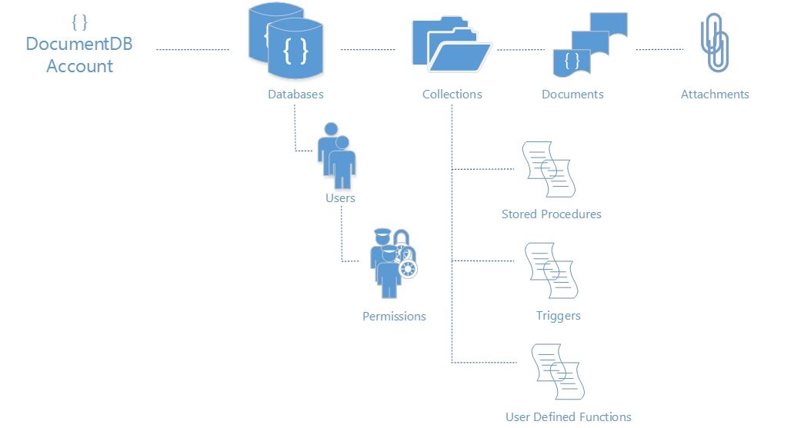
Microsoft Azure DocumentDB
Simple HTTP RESTful programming model.
All entities uniquely addressable by a logical URI.
Standard HTTP verbs and semantics – PUT, POST, PATCH, DELETE, GET, HEAD
Partitioned for scale out and replicated for HA
Granular access control through item level permissions
Attachments stored in Azure Blobs and follow document lifecycle
DocumentDB accounts scale out through the addition of capacity units with associated DB storage and throughput

Slide 46
{
“locations”:
[
{“country”: “Germany”, “city”: “Berlin”},
{“country”: “France”, “city”: “Paris”},
],
“headquarter”: “Belgium”,
“exports”:[{“city”; “Moscow”},{“city: ”Athens”}]
};
DocumentDB JSON Documents
Locations
Headquarter
Exports
0
1
Belgium
0
1
Country
City
Country
City
City
City
Germany
Berlin
France
Paris
Moscow
Athens
Notes:
Source: http://azure.microsoft.com/en-us/documentation/articles/documentdb-resources/#documents
You can insert, replace, delete, read, enumerate and query arbitrary JSON documents in a collection. DocumentDB does not mandate any schema and does not require secondary indexes in order to support querying over documents in a collection.
Being a truly open database service , DocumentDB does not invent any specialized data types (e.g. date time) or specific encodings for JSON documents. Note that DocumentDB does not require any special JSON conventions to codify the relationships among various documents; the SQL query language of DocumentDB provides very powerful hierarchical and relational query operators to query and project documents without any special annotations or need to codify relationships among documents using distinguished properties.
As with all other resources, documents can be created, replaced, deleted, read, enumerated and queried easily using either REST APIs or any of the client SDKs. Deleting a document instantly frees up the quota corresponding to all of the nested attachments. The read consistency level of documents follows the consistency policy on the database account. This policy can be overridden on a per-request basis depending on data consistency requirements of your application .When querying documents, the read consistency follows the indexing mode set on the collection. For “consistent”, this follows the account’s consistency policy.

Slide 47
Consider query needs and index policies (index policies are currently immutable)
Understand query costs and limits, and avoid scans
Pre-aggregate where possible
Query and indexing tips
Notes:
Source: http://azure.microsoft.com/en-us/documentation/articles/documentdb-indexing-policies/#performance-tuning
As you evaluate different indexing policy configurations, you should measure the storage and throughput implications of the policy through the DocumentDB APIs.
To check the storage quota and usage of a collection, run a HEAD or GET request against the collection resource, and inspect the x-ms-request-quota and the x-ms-request-usage headers. In the .NET SDK, the DocumentSizeQuota and DocumentSizeUsage properties in ResourceResponse contain these corresponding values.

Slide 48
over 425 million unique users
store 20TB of JSON document data
DocumentDB at Microsoft
available globally to serve all markets
store for 40+ app / device combinations
under 15ms writes and single digit ms reads

Slide 49

Redis Cache

Slide 50
High throughput, consistent low-latency data access to power fast, scalable Azure applications

Slide 51
Fully managed
High throughput
Azure Redis Cache
Low Latency
High performance
Secure

